Slide 1





E-COMMERCE SALES ANALYSIS
Student Details
NAME: VIGNESH V
NM ID: au612821105022
COLLEGE NAME: VARUVAN VADIVELAN INSTITUTE OF TECHNOLOGY

Slide 2

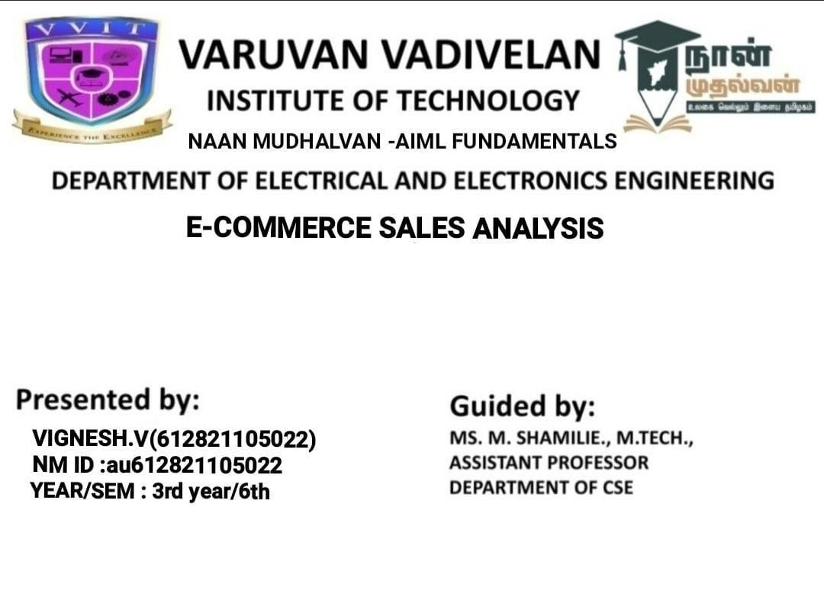
Face Emotion and Age Detection

Slide 3
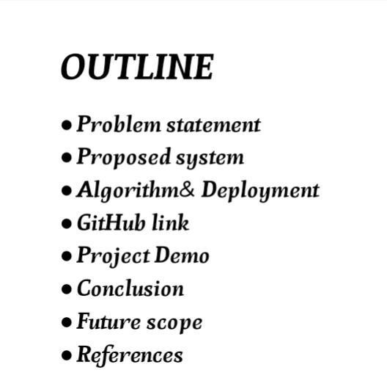


Face Emotion and Age Detection

Slide 4
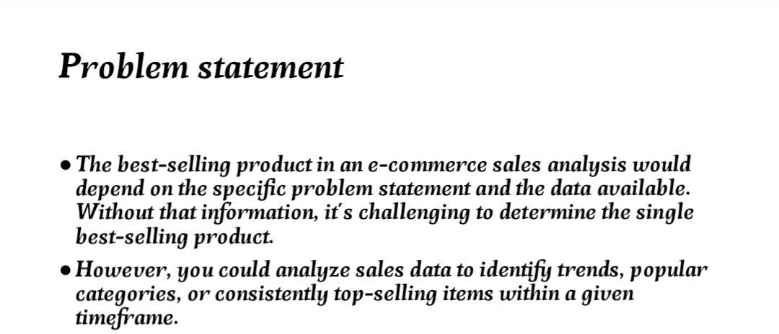
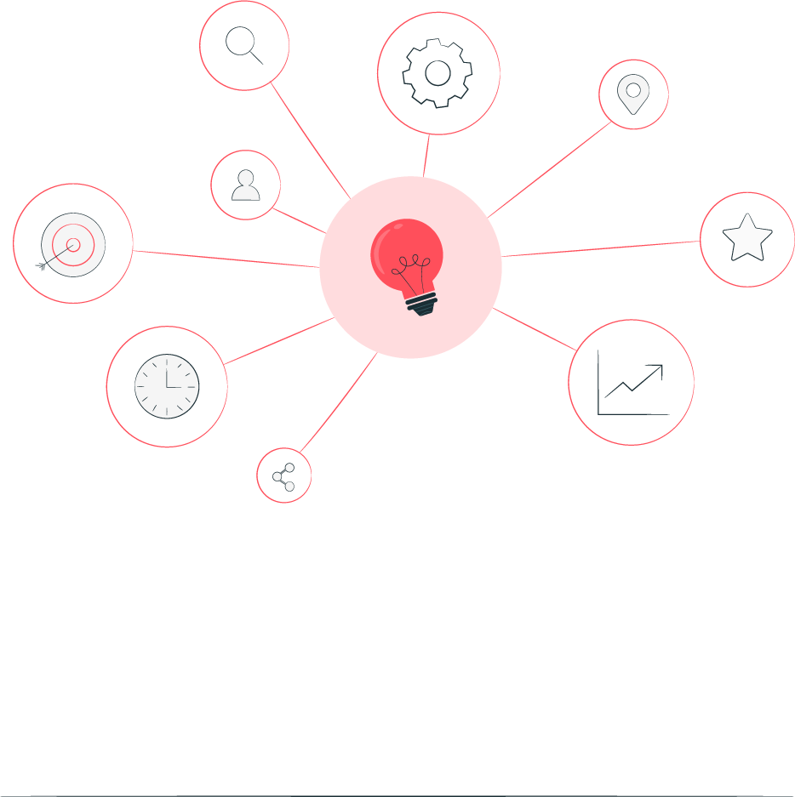
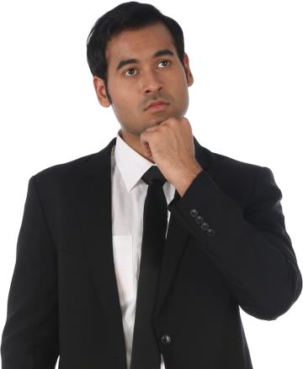
Face Emotion and Age Detection

Slide 5
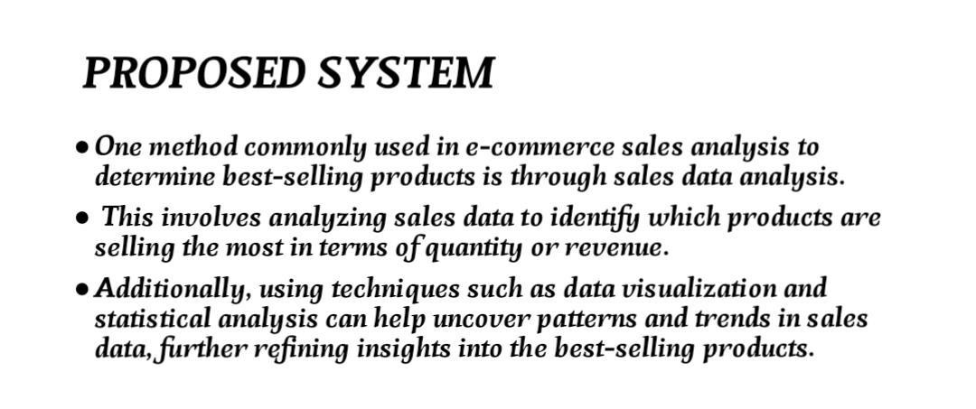


Face Emotion and Age Detection

Slide 6
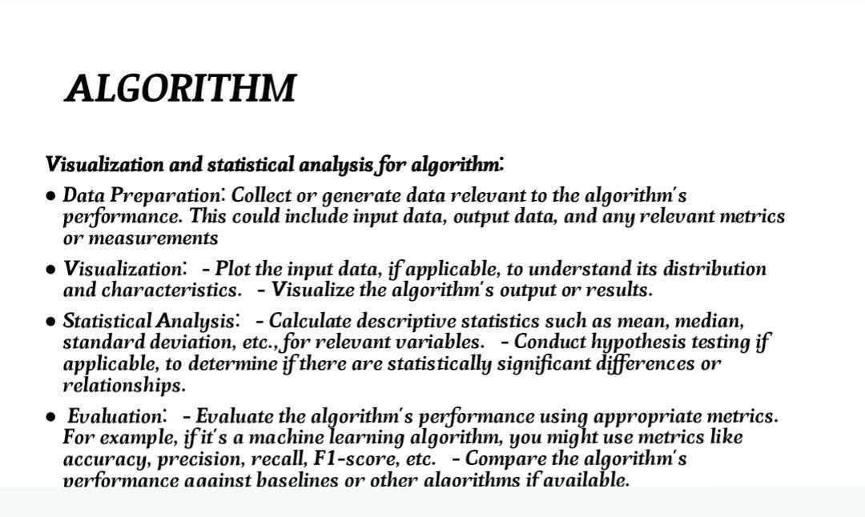
Face Emotion and Age Detection
Aim and Objective

Slide 7
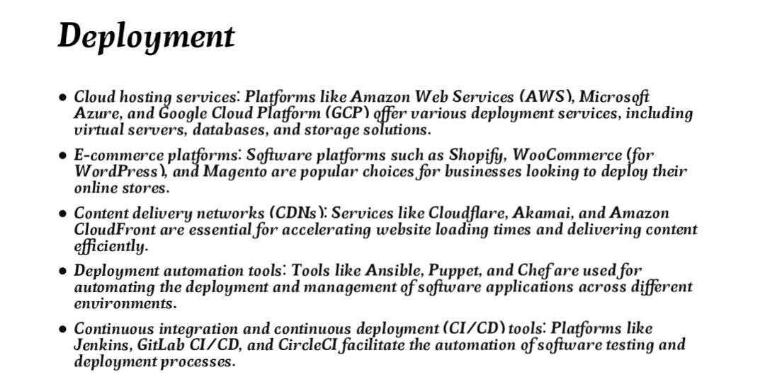
Face Emotion and Age Detection

Slide 8
Face Emotion and Age Detection
GITHUB LINK :
https://github.com/vignesh5022

Slide 9
Face Emotion and Age Detection
PROJECT DEMO
https://github.com//Vignesh5022/Vignesh_E-commerce

Slide 10

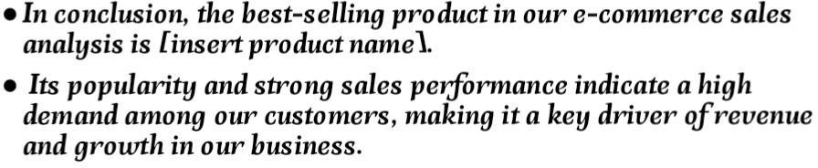
Face Emotion and Age Detection
CONCLUSION :

Slide 11

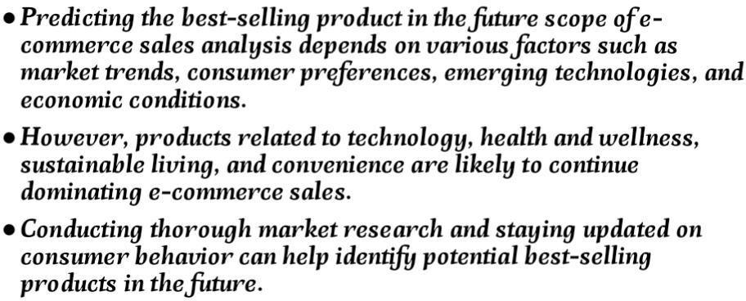
Face Emotion and Age Detection
Future Scope

Slide 12
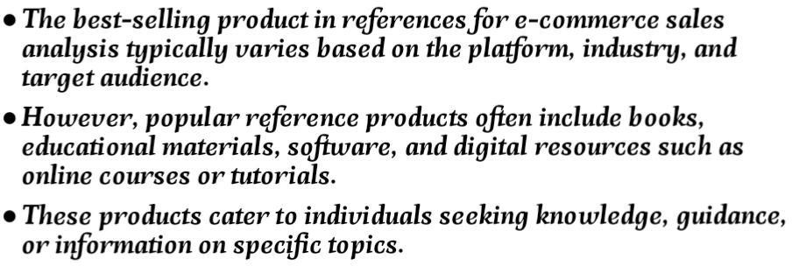
Face Emotion and Age Detection
REFERENCS

Slide 13
Thank you!
Face Emotion and Age Detection

